Slide 1
Easy Cloud
Introduction to Software engineering
CS455
Prepared by:
Rishabh Nigam(10598)
Pankaj Prateek(10479)

Slide 2
Motivation
To create an application which can be used to store and fetch data, by merging the services of various cloud storage systems, thus appearing to the users as a unified cloud platform.

Slide 3
Scope
Replacement to the paid services (for more storage) provided by various cloud storage systems

Slide 4
Technologies
Backend
Apache2, PostgreSQL, PHP5, cURL
(S)FTP servers
UI
Twitter BootStrap, HTML/PHP5
Third party APIs
Dropbox, Google Drive, Box.net, SkyDrive

Slide 5
Data Management
Upload files
Download files
Browse file list
See actual location of the file
Save a particular file in a specific cloud storage service

Slide 6
4+1 Architectural Model
Development View
Logical View
Scenarios
System and
Environment
Physical View
Process View

Slide 7
Logical View
User
Auth-tokens
Dropbox
Box.net
Google Drive
BootStrap API
API’s
Renderer
Dropbox
Box.net
Google Drive
getRenderedTable
Downloader
File List
File
Uploader
isFolder
Filename
lastModified
storedLocation
Path
Location

Slide 8
Logical View
Validator
request
Authenticator
RequestReceiver
If Authenticated
request
request and auth-token
Client
request and auth-token
API Requests
response
response
Responder
Server

Slide 9
Development View
API Manager
Dropbox
Box
Google Drive
File Manager
File Upload
File Download
File List
Renderer
Self

Slide 10
Development View
(Database Design)
Account
File Lists
Username
Dropbox Auth-token
Drive Auth-token
Box Auth-token
Username
Dropbox File list
Drive File list
Box File list
Referential integrity constraint
*File lists would be stored in a text field in a json/array format.

Slide 11
Process View
open application
Check database
Dropbox already authenticated
Drive already authenticated
Box already authenticated
Authenticate Dropbox
Authenticate Drive
Authenticate Box
Browse Files
Download
Upload
See Actual Location
See Last modified
Upload to specific
Upload to any

Slide 12
Physical View
Client
Request
Server
Upload
Apache HTTP Server 2.4.5
and FTP Server
API Calls
Cloud Server
Browser
Download
Listing
PostgreSQL 9.3.1
Operating System (Windows, Linux, OS X, Android etc.)
Operating System (Arch Linux)
*Client and Server can also be on the same machine.

Slide 13
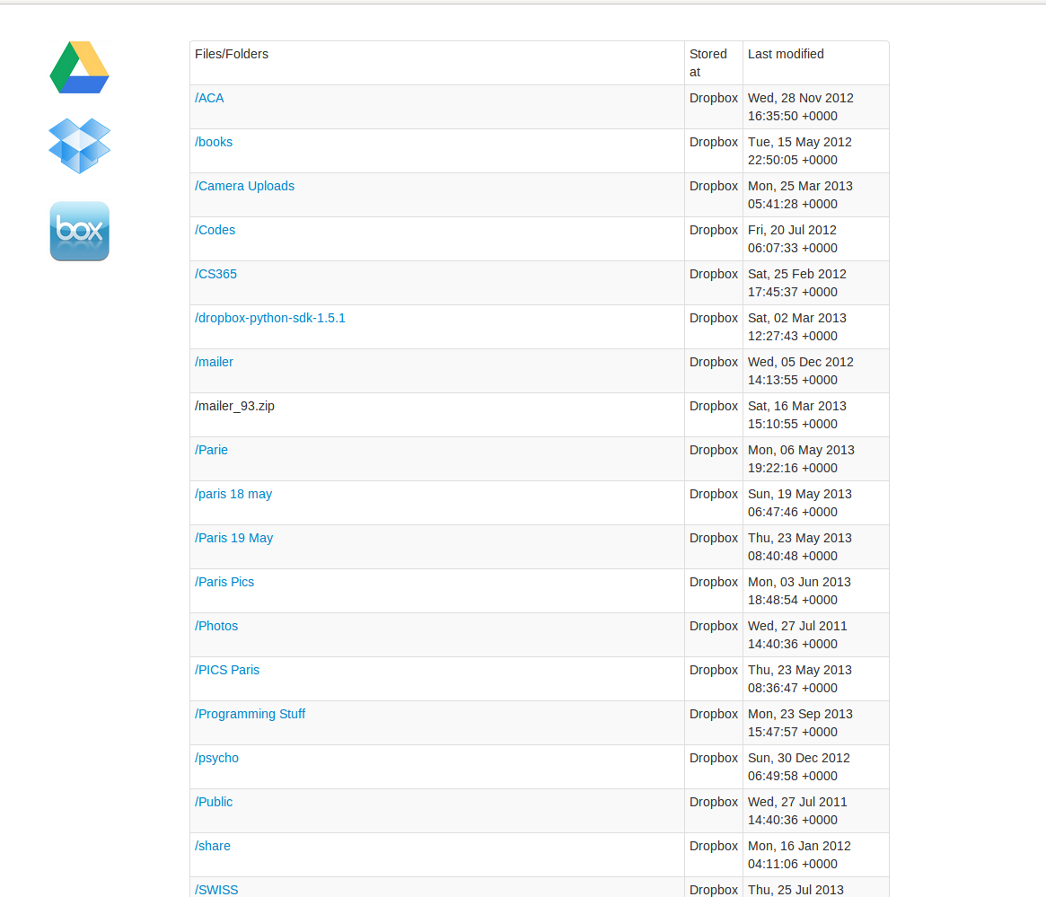
Current UI

Slide 14
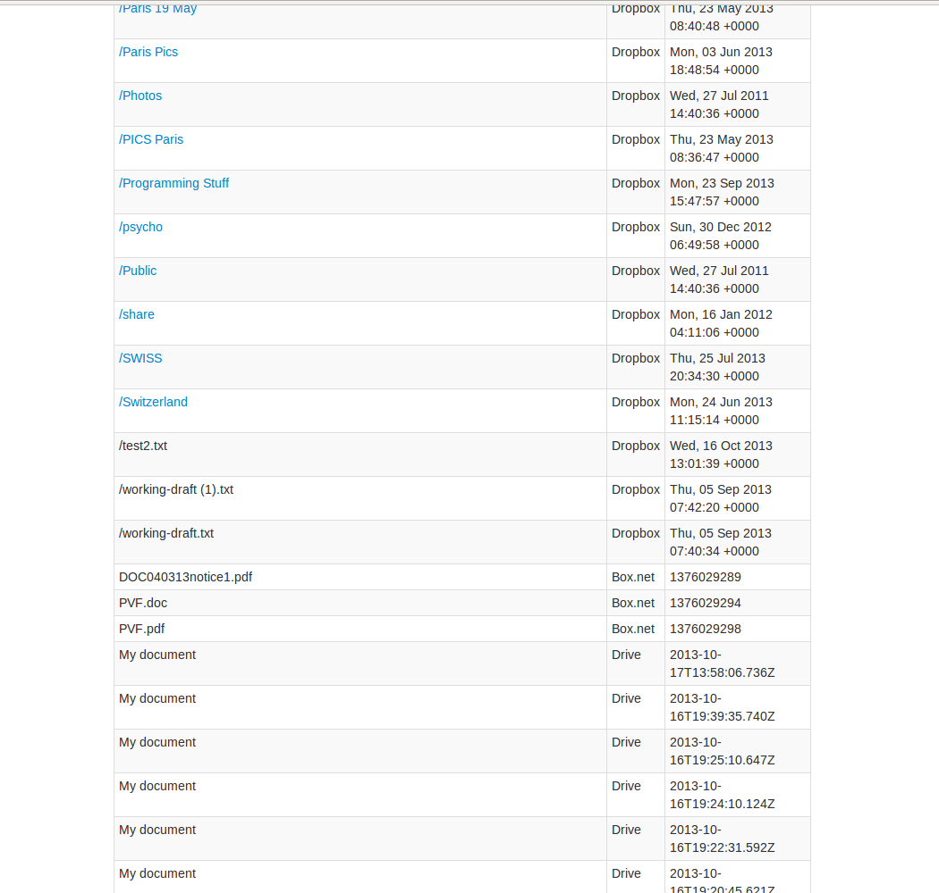
Current UI

Slide 15
THANK YOU!

